Slide 1

Department of Computer Science
University Institute of Engineering
DEPARTMENT OF COMPUTER SCIENCE & ENGINEERING
Bachelor of Engineering
Subject Name: System Programming
Subject Code: CST-315
Assemblers
DISCOVER . LEARN . EMPOWER

Slide 2
Chapter-1.2 Assemblers
Department of computer Science
Types of Assemblers
Two-Pass Assemblers
One-Pass Assemblers

Slide 3
Assembler
The basic principles of assembler operation are simple, involving just one problem, that of unresolved references.
This is a simple problem that has two simple solutions.
The problem is important, however, since its two solutions introduce, in a natural way, the two main types of assemblers namely, the one-pass and the two-pass.

Slide 4
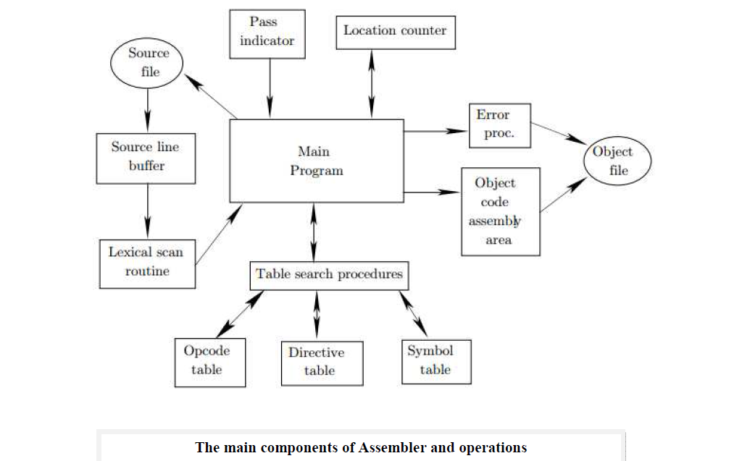

Slide 5
Assembler
Assembler divide these tasks in two passes:
Pass-1:
Define symbols and literals and remember them in symbol table and literal table respectively.
Keep track of location counter
Process pseudo-operations
Pass-2:
Generate object code by converting symbolic op-code into respective numeric op-code
Generate data for literals and look for values of symbols

Slide 6
One-pass assembler
The operation of a one-pass assembler is different.
As its name implies, this assembler reads the source file once.
During that single pass, the assembler handles both label definitions and assembly.
The only problem is future symbols.

Slide 7
Two pass Assembler
Such an assembler performs two passes over the source file.
In the first pass it reads the entire source file, looking only for label definitions.
All labels are collected, assigned values, and placed in the symbol table in this pass.
No instructions are assembled and, at the end of the pass, the symbol table should contain all the labels defined in the program.
In the second pass, the instructions are again read and are assembled, using the symbol table

Slide 8
Example
Firstly, We will take a small assembly language program to understand the working in their respective passes.
Assembly language statement format:

Slide 9
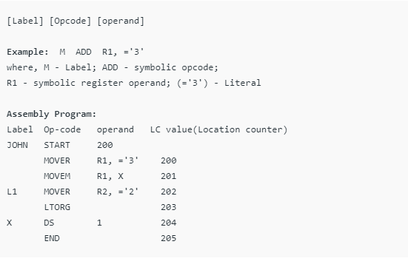

Slide 10
Example
START: This instruction starts the execution of program from location 200 and label with START provides name for the program.(JOHN is name for program)
MOVER: It moves the content of literal(=’3′) into register operand R1.
MOVEM: It moves the content of register into memory operand(X).
MOVER: It again moves the content of literal(=’2′) into register operand R2 and its label is specified as L1.
LTORG: It assigns address to literals(current LC value).
DS(Data Space): It assigns a data space of 1 to Symbol X.
END: It finishes the program execution.

Slide 11
Example
Working of Pass-1: Define Symbol and literal table with their addresses. Note: Literal address is specified by LTORG or END.
Step-1: START 200 (here no symbol or literal is found so both table would be empty)
Step-2: MOVER R1, =’3′ 200 ( =’3′ is a literal so literal table is made)

Slide 12
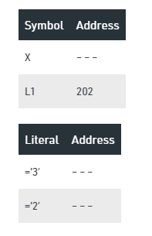
Example
Step-3: MOVEM R1, X 201 X is a symbol referred prior to its declaration so it is stored in symbol table with blank address field.
Step-4: L1 MOVER R2, =’2′ 202 L1 is a label and =’2′ is a literal so store them in respective tables

Slide 13
Example
Step-5: LTORG 203 Assign address to first literal specified by LC value, i.e., 203
Step-6: X DS 1 204 It is a data declaration statement i.e X is assigned data space of 1. But X is a symbol which was referred earlier in step 3 and defined in step 6.
This condition is called Forward Reference Problem where variable is referred prior to its declaration and can be solved by back-patching. So now assembler will assign X the address specified by LC value of current step.

Slide 14
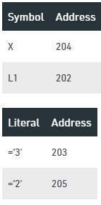
Example
Step-7: END 205
Program finishes execution and remaining literal will get address specified by LC value of END instruction. Here is the complete symbol and literal table made by pass 1 of assembler.

Slide 15
Working of Pass-2:
Pass-2 of assembler generates machine code by converting symbolic machine-opcodes into their respective bit configuration(machine understandable form).
It stores all machine-opcodes in MOT table (op-code table) with symbolic code, their length and their bit configuration.
It will also process pseudo-ops and will store them in POT table(pseudo-op table).

Slide 16
Working of Pass-2:
Various Data bases required by pass-2:
1. MOT table(machine opcode table)
2. POT table(pseudo opcode table)
3. Base table(storing value of base register)
4. LC ( location counter)

Slide 17
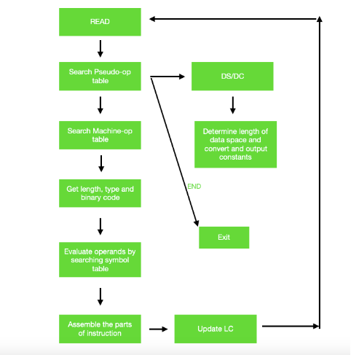
Pass Description

Slide 18
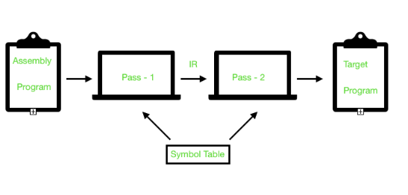
Assembler Working Diagram
As a whole assembler works as:

Slide 19
References
Department of computer Science
[PDF] Systems Programming and Operating Systems by Dhamdhere - Free Download PDF (dlscrib.com)
[PDF] Principles of Compiler Design By Alfred V. Aho & J.D.Ullman Free Download – Learnengineering.in

Slide 20
THANK YOU

